Slide 1


Project Overview
Key information about the project

Slide 2

Project Selection

Slide 3

: A Game you Really Want to Develop
Most important aspect of this module, highlights your programming skill and worth 100% of module credit
You get to select the game you want to develop. You will have some control over how it is marked.
There are compulsory hand-in points, with a final assessment at the end of the module. The assessment may involve a viva.

Slide 4



: Some Advice on Selecting a Project
Firstly, and most importantly, develop something that you think is fun.
Base your project on a simple idea that can be easily implemented within the available time.
Plan to develop a short demo and not a fully featured game

Slide 5

: Some More Advice on Selecting a Project
Include contingency planning within your project.
Use the assessment criteria (think about how your project will be marked).

Slide 6

You will work in a small team on your project (typically 4-5 students). I will act as a brokering service if needed.
This will make the project manageable. But it requires coordination and integration effort alongside flexibility.
A single mark will be awarded for the project with individual marks derived from project contributions.

Slide 7

This module does not have any practicals. You are responsible for investigating any referenced material and setting aside sufficient time to enable you to develop your programming skills.
There are good reasons for doing things this way:
It’s what actual programmers do – during your placement year you will need to pick up new languages with little support.
Most 3rd and 4th year modules have no practicals. The University aims to ensure that all graduates are independent learners.

Slide 8

As a counter balance, when marking the project I will fully take into account the effort that was needed to pick up and learn Android programming

Slide 9
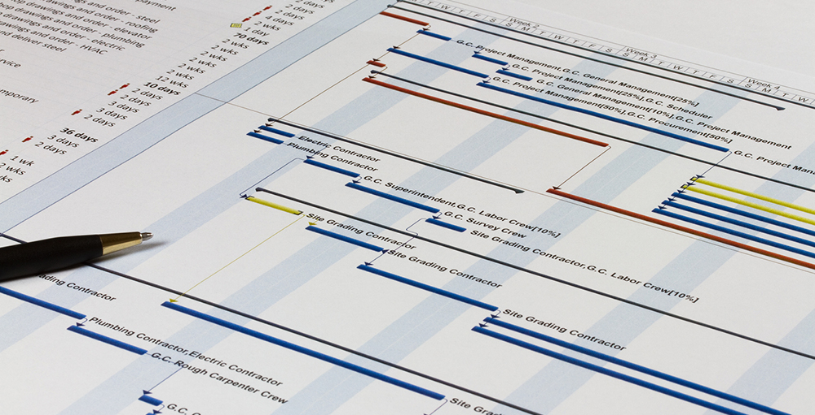
Project Timeline

Slide 10
Semester 1
Week 1
Week 2
Week 3
Week 4
Week 5
Week 6
Week 7
Week 8
Week 9
Week 10
Week 11
Week 12
Team Formation and Game Idea
You will get into your teams and start exploring game ideas.
Sprint 1
The first sprint will be closely based on developing the core input, graphical and sound elements of your game (based on lecture content).
End
Week 3
Sprint 2
In the second sprint you will combine together the core elements to make your own game architecture.
Team Formation and Initial Game Concept
This submission will outline your team and describe your planned game and its associated features. You will receive feedback on your planned game in terms of complexity and required effort.
Sprint 3
In the third sprint you will bring to life a simple but crudely playable version of your game.
End
Week 9
Architecture Submission
This submission will detail the architectural design of your game, including functionality developed to date. Feedback will be provided on your design and your progress to date.

Slide 11
Semester 2
Week 1
Week 2
Week 3
Week 4
Week 5
Week 6
Week 7
Sprint 4
In the 4th sprint you will add the wow factor to your game, adding more extensive/complex functionality
Sprint 5
In the last sprint you will add the finishing touches and refinements to your game and submit.
Start
Week 1
End
Week 3
Start
Week 7
Summative Assessment
The project will be considered against each assessment area and an overall mark awarded to each team member.
Progress Update
Submission of a runnable snapshot of your project. You will be able to highlight areas on which to receive feedback.
Progress Update
Submission of a runnable snapshot of your project. You will be able to highlight areas on which to receive feedback.
Final Submission
Your completed game will be submitted.
Viva
You may be required to sit and pass a viva (used if the team cannot agree a set of individual contributions).
Agreed Contributions
The team will agree the contribution of each team to the submitted project.
Demo
You may be required to demonstrate your project to company representatives and other students in the School.

Slide 12

Project Assessment

Slide 13

: Areas of Assessment
Each project will be marked out of 100 and judged against the following categories of assessment:
Professionalism
Quality of architectural design
Use of input, graphics and/or sound
Extent of game features
Complexity of game algorithms
Coding style and code quality

Slide 14
: Area Weightings
You can decide how 50 marks (out of the total 100 marks) will be allocated. Doing this, you can adapt the marking scheme to your chosen game.
Category | Mark Range | Flexibility
Professionalism | 10 marks | Fixed
Quality of architectural design | 15 marks | Fixed
Use of input/graphics/sound | 5-25 marks | Variable
Extent of game features | 5-25 marks | Variable
Complexity of game algorithms | 5-25 marks | Variable
Coding style and code quality | 25 marks | Fixed

Slide 15

: Code Reuse
You can make use of existing algorithms, code fragments, classes and libraries as desired.
Software versioning will be used to track the development of your project.
Upon submission all projects will be subject to an on-line plagiarism test.
Vivas will be held to assure authenticity if there is any uncertainty.

Slide 16


The individual mark you receive will be based on:
the quality of the project developed by the team,
what the team think of your overall contribution, and
the code that is directly attributable to your efforts.

Slide 17

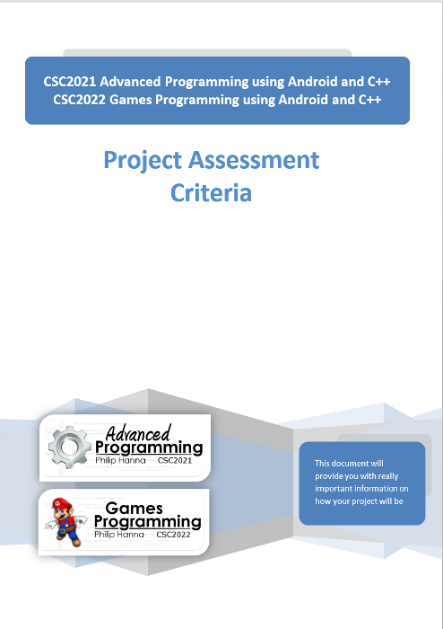
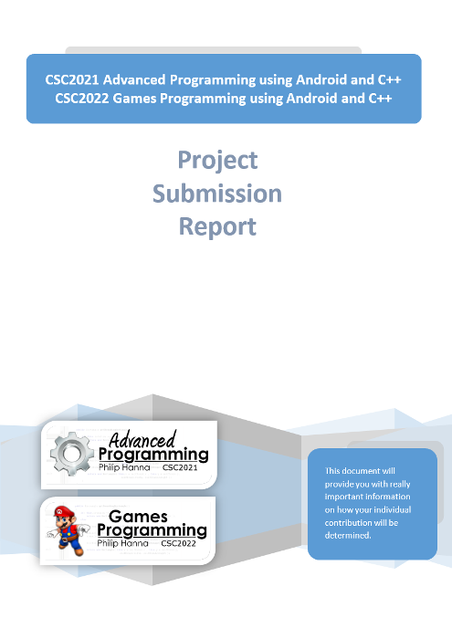
For the full story on how your project will be assessed scrutinise the following:
Project Assessment Criteria –breakdown of what it takes to achieve a 1st, 2.1, etc. in each category of assessment.
Project Submission Report – details of what will be submitted and how individual contributions will be determined.
To do:
Read these

Slide 18

Key takeaways:
The project is at the heart of this module.
You should aim to develop
a simple and fun demo.
Be sure to carefully read the assessment criteria and project submission documents.

